Slide 1
Unit 3 – Part 2
By
Dr Cristin R

Slide 2
Iterative Process Planning
A good work breakdown structure and its synchronization with the process framework are critical factors in software project success.
Development of a work breakdown structure dependent on the project management style, organizational culture, customer preference, financial constraints, and several other hard-to-define, project-specific parameters.

Slide 3
Iterative Process Planning
A WBS is simply a hierarchy of elements that decomposes the project plan into
the discrete work tasks. A WBS provides the following information structure:
A delineation of all significant work
A clear task decomposition for assignment of responsibilities
A framework for scheduling, budgeting, and expenditure tracking
Many parameters can drive the decomposition of work into discrete tasks:
product subsystems, Components, functions, organizational units, life-cycle
phases, even geographies. Most systems have a first-level decomposition by
subsystem. Subsystems are then decomposed into their components, one of
which is typically the software.

Slide 4
Iterative Process Planning
CONVENTIONAL WBS ISSUES
Conventional work breakdown structures frequently suffer from
three fundamental flaws.
They are prematurely structured around the product design.
They are prematurely decomposed, planned, and budgeted in either too much or too little detail.
They are project-specific, and cross-project comparisons are usually difficult or impossible.

Slide 5
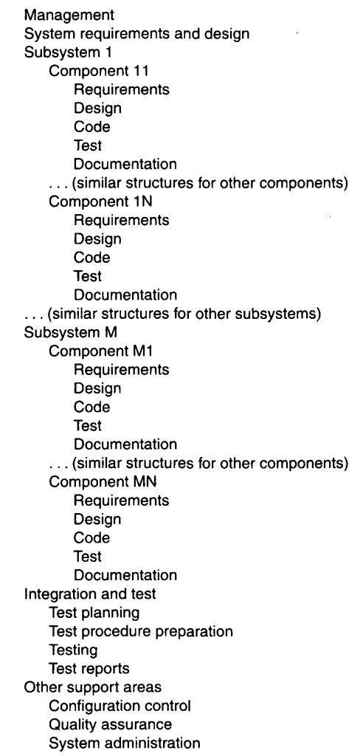
Iterative Process Planning

Slide 6
Iterative Process Planning
EVOLUTIONARY WORK BREAKDOWN STRUCTURES
An evolutionary WBS should organize the planning elements around the process framework rather than the product framework. The basic recommendation for the WBS is to organize the hierarchy as follows:
First-level WBS elements are the workflows (management, environment, requirements, design, implementation, assessment, and deployment).
Second-level elements are defined for each phase of the life cycle (inception, elaboration, construction, and transition).
Third-level elements are defined for the focus of activities that produce the artifacts of each phase.
A default WBS consistent with the process framework (phases, workflows, and artifacts). This recommended structure provides one example of how the elements of the process framework can be integrated into a plan. It provides a framework for estimating the costs and schedules of each element, allocating them across a project organization, and tracking expenditures.

Slide 7
Iterative Process Planning
EVOLUTIONARY WORK BREAKDOWN STRUCTURES
The structure shown is intended to be merely a starting point. It needs to be tailored to the specifics of a project in many ways.
Scale. Larger projects will have more levels and substructures.
Organizational structure. Projects that include subcontractors or span multiple organizational entities may introduce constraints that necessitate different WBS allocations.
Degree of custom development. Depending on the character of the project, there can be very different emphases in the requirements, design, and implementation workflows.
Business context. Projects developing commercial products for delivery to a broad customer base may require much more elaborate substructures for the deployment element.
Precedent experience. Very few projects start with a clean slate. Most of them are developed as new generations of a legacy system (with a mature WBS) or in the context of existing organizational standards (with preordained WBS expectations).

Slide 8
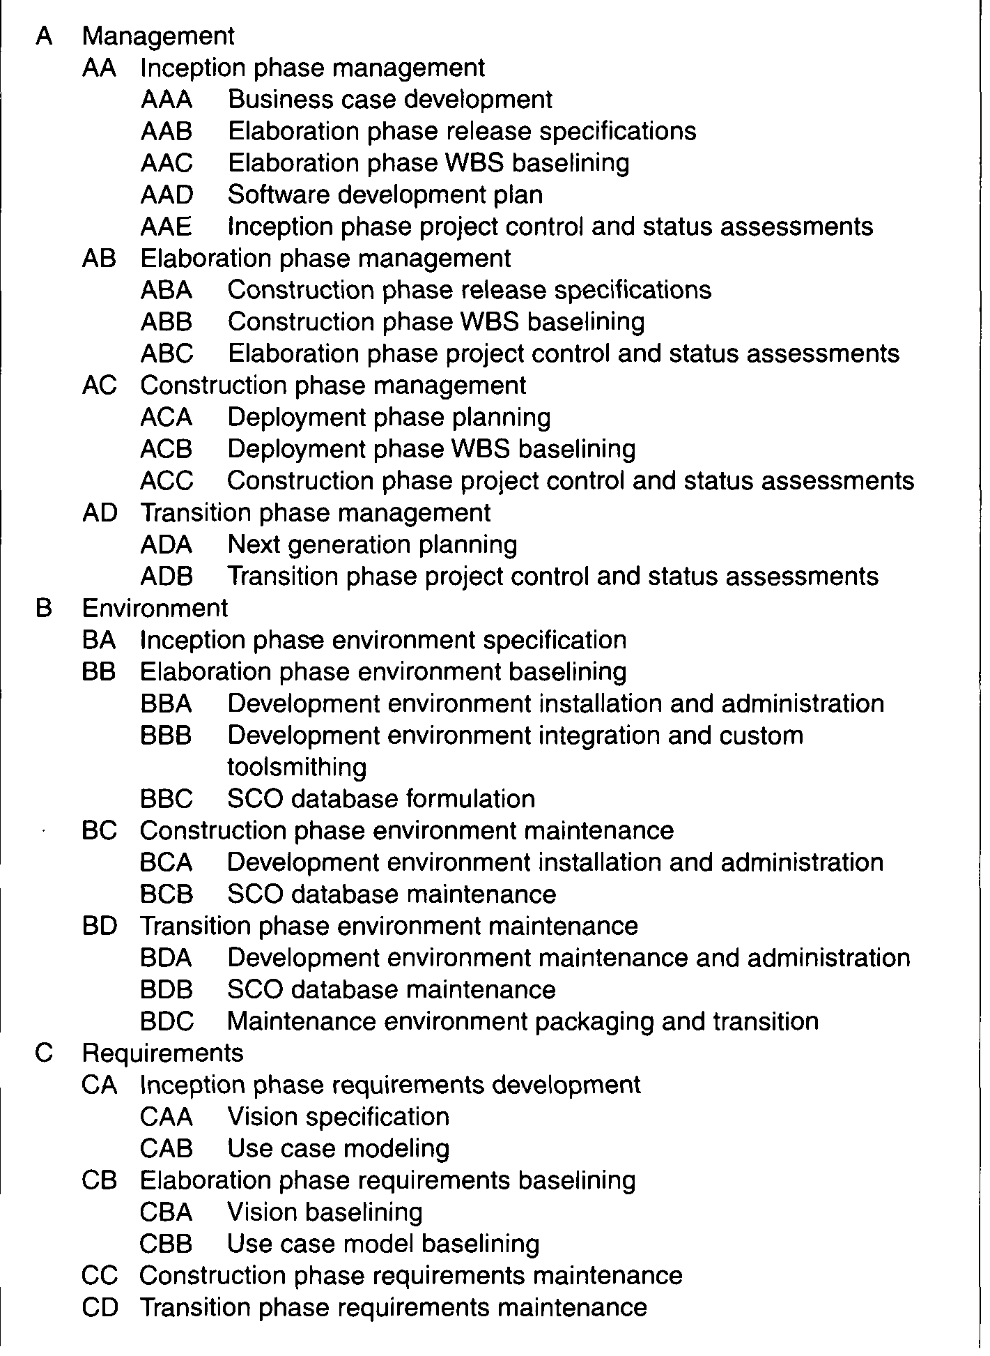
Iterative Process Planning

Slide 9
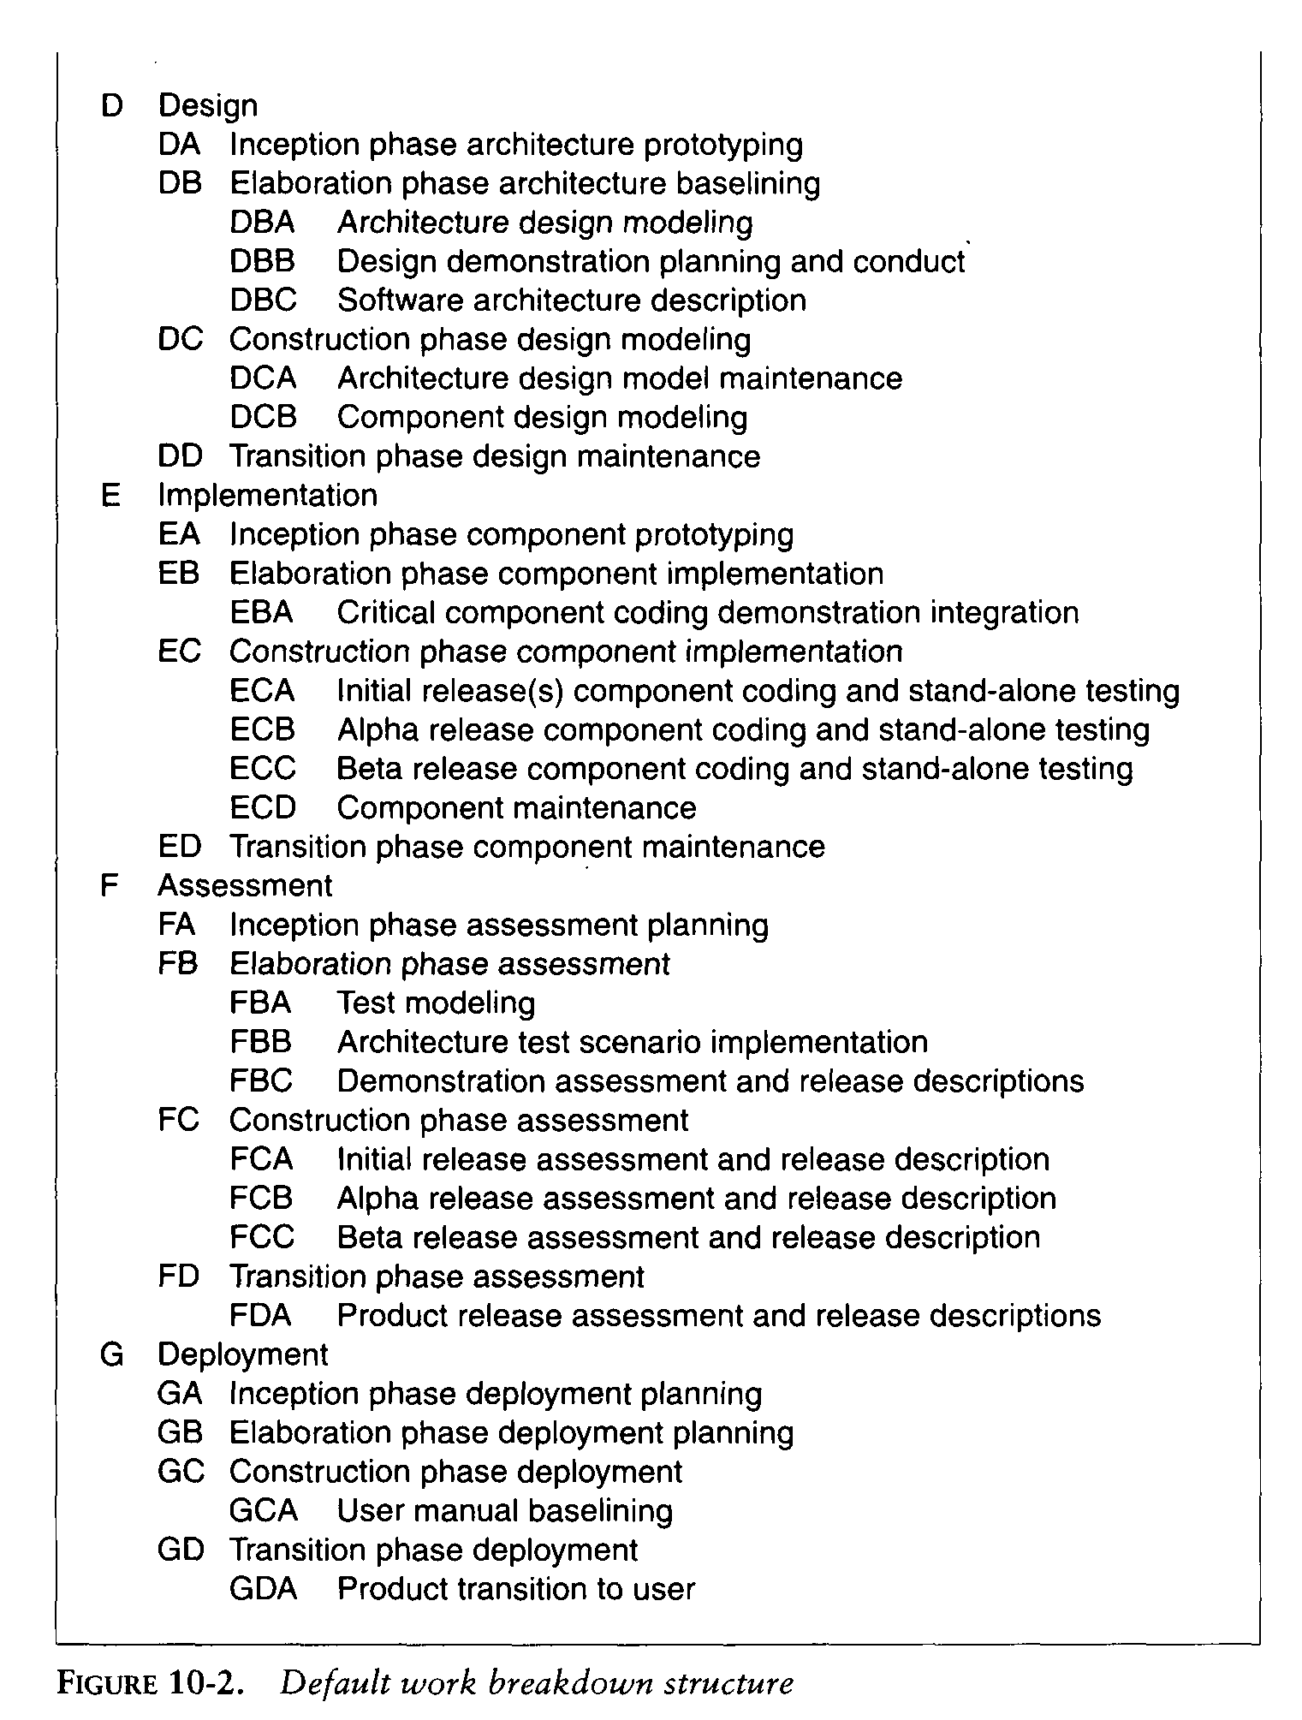
Iterative Process Planning

Slide 10
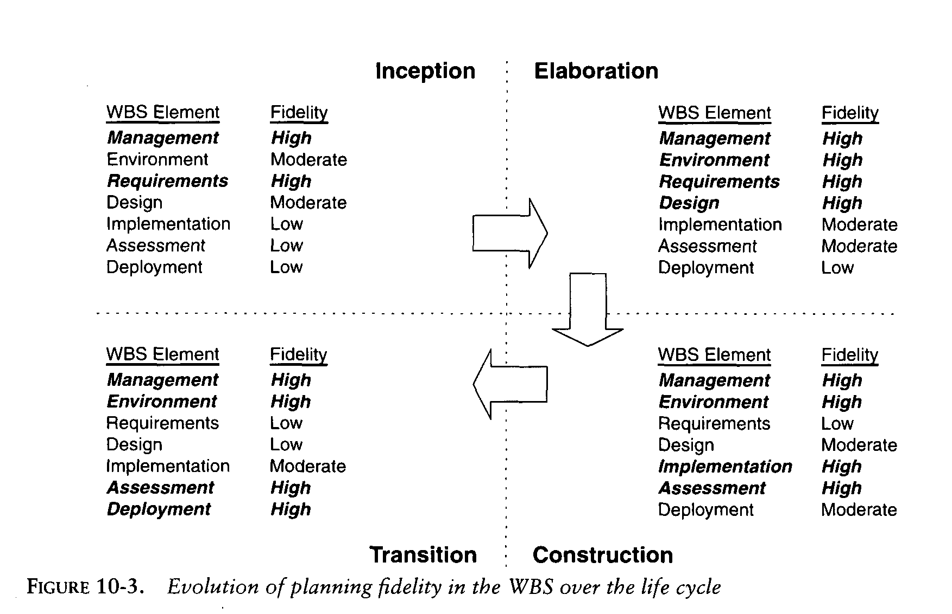
Iterative Process Planning

Slide 11
PLANNING GUIDELINES
Software projects span a broad range of application domains.
It is valuable but risky to make specific planning recommendations independent of project context.
Project-independent planning advice is also risky.
There is the risk that the guidelines may be adopted blindly without being adapted to specific project circumstances.
Two simple planning guidelines should be considered when a project plan is being initiated or assessed.
The first guideline, detailed in Table 10-1, prescribes a default allocation of costs among the first-level WBS elements.
The second guideline, detailed in Table 10-2, prescribes the allocation of effort and schedule across the lifecycle phases.

Slide 12
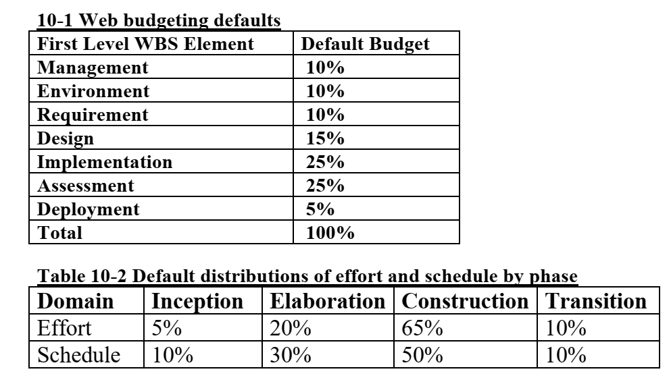
PLANNING GUIDELINES

Slide 13
THE COST AND SCHEDULE ESTIMATING PROCESS
Project plans need to be derived from two perspectives. The first is a forward-looking, top-down approach. It starts with an understanding of the general requirements and constraints, derives a macro-level budget and schedule, then decomposes these elements into lower level budgets and intermediate milestones. From this perspective, the following planning sequence would occur:
The software project manager (and others) develops a characterization of the overall size, process, environment, people, and quality required for the project.
A macro-level estimate of the total effort and schedule is developed using a software cost estimation model.
The software project manager partitions the estimate for the effort into a top-level WBS using guidelines such as those in Table 10-1.
At this point, subproject managers are given the responsibility for decomposing each of the WBS elements into lower levels using their top-level allocation, staffing profile, and major milestone dates as constraints.

Slide 14
THE COST AND SCHEDULE ESTIMATING PROCESS
The second perspective is a backward-looking, bottom-up approach. We start with the end in mind, analyze the micro-level budgets and schedules, then sum all these elements into the higher level budgets and intermediate milestones. This approach tends to define and populate the WBS from the lowest levels upward. From this perspective, the following planning sequence would occur:
The lowest level WBS elements are elaborated into detailed task.
Estimates are combined and integrated into higher level budgets and milestones.
Comparisons are made with the top-down budgets and schedule milestones.
Milestone scheduling or budget allocation through top-down estimating tends to exaggerate the project management biases and usually results in an overly optimistic plan. Bottom-up estimates usually exaggerate the performer biases and result in an overly pessimistic plan.

Slide 15
THE COST AND SCHEDULE ESTIMATING PROCESS
These two planning approaches should be used together, in balance, throughout the life cycle of the project.
During the engineering stage, the top-down perspective will dominate because there is usually not enough depth of understanding nor stability in the detailed task sequences to perform credible bottom-up planning.
During the production stage, there should be enough precedent experience and planning fidelity that the bottom-up planning perspective will dominate.
Top-down approach should be well tuned to the project specific parameters, so it should be used more as a global assessment technique. Figure 10-4 illustrates this lifecycle planning balance.

Slide 16
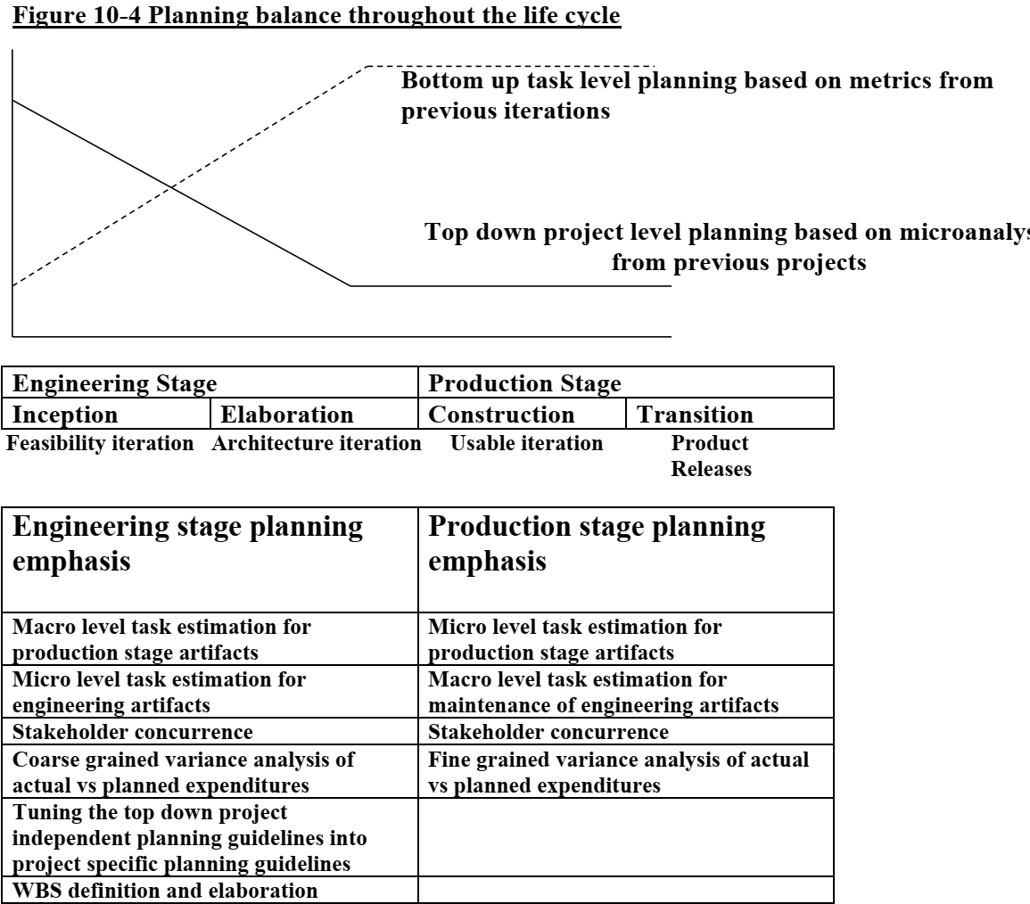
THE COST AND SCHEDULE ESTIMATING PROCESS

Slide 17
THE ITERATION PLANNING PROCESS
Planning is concerned with defining the actual sequence of intermediate results.
An evolutionary build plan is schedule as early conjecture evolves into well-understood project circumstances.
Iteration is used to mean a complete synchronization across the project, with a well-orchestrated global assessment of the entire project baseline.
Inception iterations
The early prototyping activities integrate the foundation components of a candidate architecture and provide an executable framework for elaborating the critical use cases of the system.
This framework includes existing components, commercial components, and custom prototypes sufficient to demonstrate a candidate architecture and sufficient requirements understanding to establish a credible business case, vision, and software development plan.

Slide 18
THE ITERATION PLANNING PROCESS
Elaboration iterations.
These iterations result in architecture, including a complete framework and infrastructure for execution.
Upon completion of the architecture iteration, a few critical use cases should be demonstrable:
(1) initializing the architecture,
(2) injecting a scenario to drive the worst-case data processing flow through the system (for example, the peak transaction throughput or peak load scenario)
(3) injecting a scenario to drive the worst-case control flow through the system (for example, orchestrating the fault-tolerance use cases).
Construction iterations.
Most projects require at least two major construction iterations: an alpha release and a beta release.

Slide 19
THE ITERATION PLANNING PROCESS
Transition iterations
Most projects use a single iteration to transition a beta release into the final product.
The general guideline is that most projects will use between four and nine iterations. The typical project would have the following six-iteration profile:
One iteration in inception: an architecture prototype
Two iterations in elaboration: architecture prototype and architecture baseline
Two iterations in construction: alpha and beta releases
One iteration in transition: product release
A very large or unprecedented project with many stakeholders may require additional inception iteration and two additional iterations in construction, for a total of nine iterations.

Slide 20
PRAGMATIC PLANNING
Even though good planning is more dynamic in an iterative process, doing it accurately is far easier.
While executing iteration N of any phase, the software project manager must be monitoring and controlling against a plan that was initiated in iteration N - 1 and must be planning iteration N + 1.
The art of good project· management is to make trade-offs in the current iteration plan and the next iteration plan based on objective results in the current iteration and previous iterations.
Aside from bad architectures and misunderstood requirements, inadequate planning (and subsequent bad management) is one of the most common reasons for project failures.

Slide 21
PRAGMATIC PLANNING
Conversely, the success of every successful project can be attributed in part to good planning.
A project's plan is a definition of how the project requirements will be transformed into' a product within the business constraints.
It must be realistic, it must be current, it must be a team product, it must be understood by the stakeholders, and it must be used.
Plans are not just for managers. The more open and visible the planning process and results, the more ownership there is among the team members who need to execute it. Bad, closely held plans cause attrition. Good, open plans can shape cultures and encourage teamwork.

